Slide 2
EFFICIENT PROCESSING WITH SPARSE VECTORS
• Vocabulary and therefore dimensionality of vectors can be very large, ~104 .
• However, most documents and queries do not contain most words, so vectors are sparse (i.e. most entries are 0).
Need efficient methods for storing and computing with sparse vectors.
• Store vectors as linked lists of non-zero-weight tokens paired with a weight. – Space proportional to number of unique tokens (n) in document.
– Requires linear search of the list to find (or change) the weight of a specific token.
Requires quadratic time in worst case to compute vector for a document:
• Index tokens in a document in a balanced binary tree or trie with weights stored with tokens at the leaves.

Slide 3
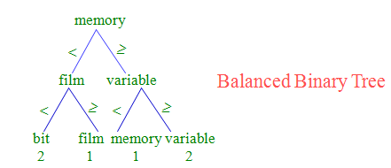
Space overhead for tree structure: ~2n nodes.

Slide 4
O(log n) time to find or update weight of a specific token.
O(n log n) time to construct vector.
Need software package to support such data structures.

Slide 5
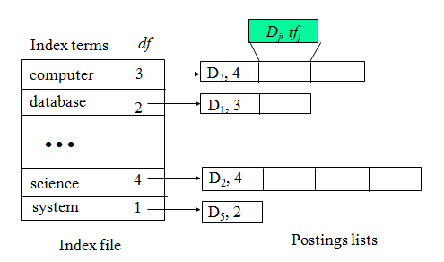
Implementation Based on Inverted Files

Slide 6
Algorithm
Create an empty HashMap, H;
For each document, D, (i.e. file in an input directory):
Create a HashMapVector,V, for D;
For each (non-zero) token, T, in V:
If T is not already in H, create an empty
TokenInfo for T and insert it into H;
Create a TokenOccurence for T in D and
add it to the occList in the TokenInfo for T;
Compute IDF for all tokens in H;
Compute vector lengths for all documents in H;

